Slide 1
Processing Data on Air Pollution in Europe Using a Modern Data Platform
Piotr Slusarczyk
Notes:
The dataset under examination is the 'StackOverflow2013' database, which spans from the years 2008 to 2013. This comprehensive dataset provides a rich opportunity for various analytical explorations and can offer valuable insights into the trends, patterns, and dynamics of the Stack Overflow community during its early years.
25’’

Slide 2
Air Pollution: Defining the Problem
Air pollution is causing significant health issues globally.
Nowadays, meteorological stations around the world collect air quality data.
How can we utilize this data to identify areas with unhealthy air?
Key Pollutants:
Particulate matter (PM2.5 and PM10) that can penetrate the respiratory system.
Nitrogen oxides (NOx) contributing to smog and acid rain.
Sulphur dioxide (SO2) from burning fossil fuels, leading to acid rain.
Carbon monoxide (CO), a toxic gas from incomplete combustion.
Ammonia (NH3) from agricultural activities and industrial processes.
Ground-level ozone (O3), a harmful air pollutant from chemical reactions in sunlight.
Notes:
In this part of the presentation, I'm focusing on the data source that I used for the analysis. I have chosen the Stack Overflow database for a few key reasons:
Firstly, this database is derived from the public Stack Overflow data export, which is a rich dataset used widely in the tech community for analysis and training. It's not just a simple dataset; it reflects real-world distributions of numbers, dates, and strings, making it an excellent candidate for realistic data analysis scenarios.
For my purposes, I've selected the medium option – the 50GB StackOverflow2013 database, which expands from a 10GB compressed file. This particular dataset contains data from 2008 to 2013.
The data comes in the form of .mdf files, which are the primary database file types used by SQL Server. This makes it convenient as they can be attached directly to SQL Server without any additional conversion, saving time and simplifying the setup process.
68’’

Slide 3
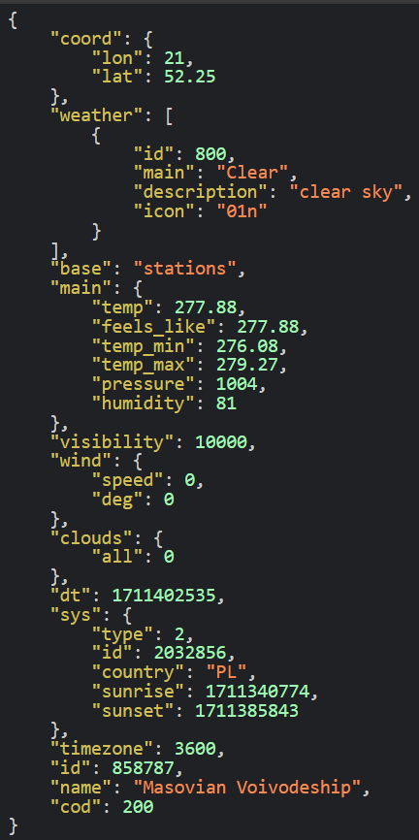
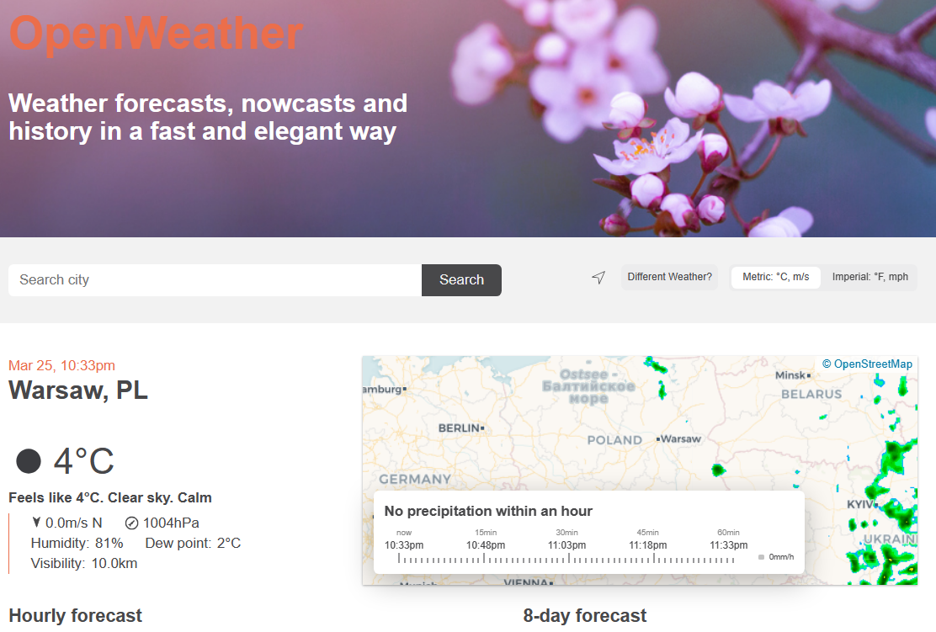
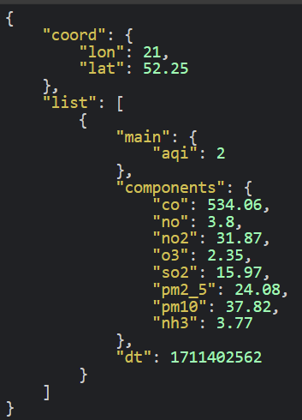
Data Source – Open Weather API
Notes:
In this part of the presentation, I'm focusing on the data source that I used for the analysis. I have chosen the Stack Overflow database for a few key reasons:
Firstly, this database is derived from the public Stack Overflow data export, which is a rich dataset used widely in the tech community for analysis and training. It's not just a simple dataset; it reflects real-world distributions of numbers, dates, and strings, making it an excellent candidate for realistic data analysis scenarios.
For my purposes, I've selected the medium option – the 50GB StackOverflow2013 database, which expands from a 10GB compressed file. This particular dataset contains data from 2008 to 2013.
The data comes in the form of .mdf files, which are the primary database file types used by SQL Server. This makes it convenient as they can be attached directly to SQL Server without any additional conversion, saving time and simplifying the setup process.
68’’

Slide 4







Steps – Modern Data Platform
Ingest
Step 1
Extracting data from API,
copying CSV files for data enrichment.
Storage
Step 3
Saving data from Kafka consumer to a Delta table, storing CSV files in DBFS.
Processing
Step 4
In Spark: converting data to proper schemas and cleaning
Analysis
Step 5
In Spark: sorting, aggregating, determining coefficients.
Serving
Step 6
Storing data in Azure SQL Database, Displaying figures and maps in an Azure App Service application.
Streaming
Step 2
Streaming data from Azure App Service application through Kafka
Notes:
The slide shows how the whole project looked like.
I began by downloading the database and establishing a connection to SQL Server, by attaching the downloaded database, laying the groundwork for the subsequent stages.
I then conducted data cleaning, ensuring the data types were correct and identifying any issues. This step was crucial for proper conversion to CSV.
Using BCP from command line, I converted the data into a CSV format.
I compressed the data into gzip format to make it smaller, which saves time when sending the data to Databricks.
To streamline the workflow, I set up a Docker container with Databricks CLI, simplifying the transfer of everything to Databricks.
Moving forward, I used Spark to convert the compressed CSV files into the Parquet format.
Finally, using Scala, I analyzed the data, and with Python's Pandas and Matplotlib libraries, I created charts that clearly depict the insights I've gleaned.
Each step was pivotal in transforming the data to successfully complete the project.
80’’

Slide 5
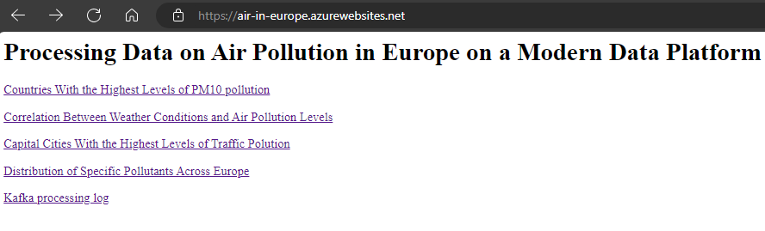
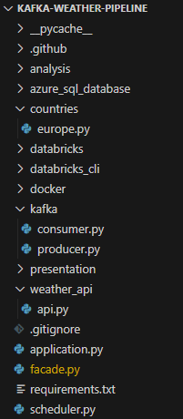
Ingest
Python Flask application deployed on Azure.
Scheduler reading data from the Open Weather API and sweeping the coordinates of Europe.
CSV files with coordinates of capital cities and ISO names of countries are copied to Azure through the Databricks CLI.
Notes:
In this slide, I'm detailing the efficient process of exporting data from SQL Server to CSV and then compressing it for optimal transfer speed.
I start by using BCP, which stands for Bulk Copy Program, a tool provided by SQL Server. It's the fastest method available to perform large-scale data exports to CSV format, ensuring speed and efficiency. I specify the view names that form the collection of data I wish to export, and then I initiate a loop to process each view individually.
Once the CSV files are generated, I use 7-Zip to compress them into gzip format. One of the key advantages of gzip is its compatibility with Databricks' file system. It can read gzip files directly, which means there's no need to decompress them on the platform, saving valuable processing time and simplifying the data pipeline.
The bottom part of the slide shows the actual script that orchestrates this entire process: from setting environment variables for BCP to executing the compression commands and cleaning up interim files. This script is the backbone of the procedure, handling everything from data extraction to final file compression, ready for sending to Databricks.
67’’

Slide 6

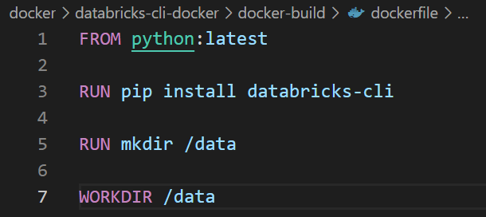

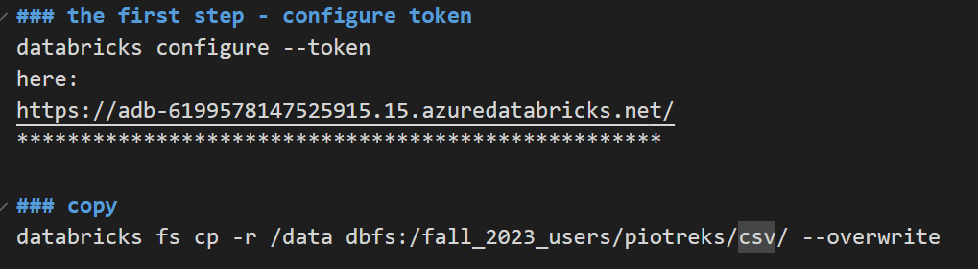
Storage - Creating a Docker container with Databricks CLI, Copying Files to Databricks.
1. Defining a dockerfile
5. The result
2. Creating an image
3. Running the docker container
4. Copying to Databricks
Notes:
In this section of the presentation, I'm going to walk you through the process of creating a Docker container equipped with Databricks CLI for the purpose of transferring files efficiently to Databricks.
I began by defining a Dockerfile. This file is a blueprint for Docker, describing the environment needed to run Databricks CLI. It's based on a Python image, installs the Databricks CLI, and sets a working directory.
Next, I created an image from the Dockerfile. The command shown on the slide builds the Docker image, which contains all the necessary components to run the Databricks CLI.
Once the image was ready, I proceeded to run the Docker container. This step involves executing a Docker run command, which initiates a container instance where I can execute Databricks CLI commands.
The fourth step was to copy the CSV files to Databricks. To do this securely, I first configured access to Databricks using a token. This ensures that the connection to Databricks is secure and that only authorized commands are executed. Once the token was configured, I used the Databricks CLI to copy files from the local data directory to the Databricks file system, replacing any existing files with the same name.
The result, which you can see on the right, is the list of files successfully copied to Databricks. These are the gzipped CSV files now stored in the Databricks file system, ready to be used for further conversion and data analysis.
84’’

Slide 7
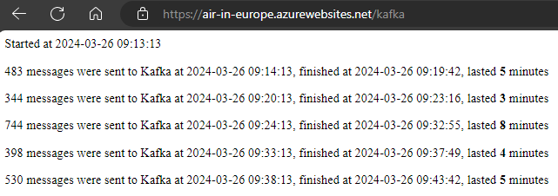
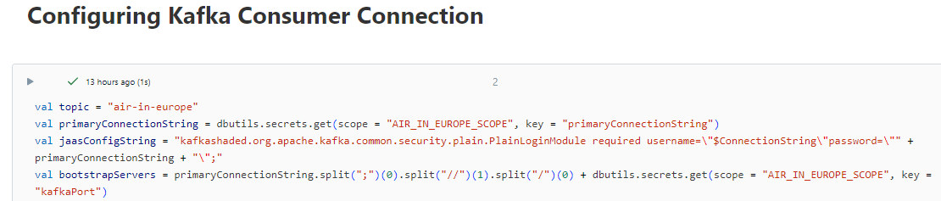
Streaming
A Kafka producer written in Python that sends the raw data regularly to Azure Event Hubs
Producer, scheduler, and application log components are deployed on the same Azure Flask application.
A Kafka consumer implemented on Azure Databricks
Notes:
In this slide, I'm detailing the efficient process of exporting data from SQL Server to CSV and then compressing it for optimal transfer speed.
I start by using BCP, which stands for Bulk Copy Program, a tool provided by SQL Server. It's the fastest method available to perform large-scale data exports to CSV format, ensuring speed and efficiency. I specify the view names that form the collection of data I wish to export, and then I initiate a loop to process each view individually.
Once the CSV files are generated, I use 7-Zip to compress them into gzip format. One of the key advantages of gzip is its compatibility with Databricks' file system. It can read gzip files directly, which means there's no need to decompress them on the platform, saving valuable processing time and simplifying the data pipeline.
The bottom part of the slide shows the actual script that orchestrates this entire process: from setting environment variables for BCP to executing the compression commands and cleaning up interim files. This script is the backbone of the procedure, handling everything from data extraction to final file compression, ready for sending to Databricks.
67’’

Slide 8

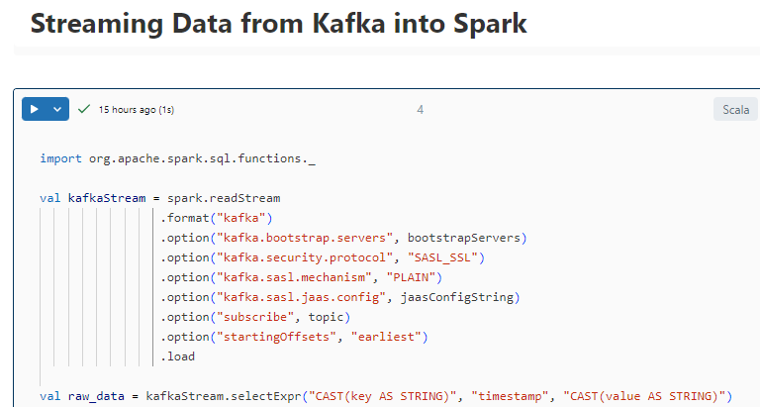
Streaming
Reading the stream from the beginning.
Converting the key and value to strings.
Notes:
In this slide, I'm detailing the efficient process of exporting data from SQL Server to CSV and then compressing it for optimal transfer speed.
I start by using BCP, which stands for Bulk Copy Program, a tool provided by SQL Server. It's the fastest method available to perform large-scale data exports to CSV format, ensuring speed and efficiency. I specify the view names that form the collection of data I wish to export, and then I initiate a loop to process each view individually.
Once the CSV files are generated, I use 7-Zip to compress them into gzip format. One of the key advantages of gzip is its compatibility with Databricks' file system. It can read gzip files directly, which means there's no need to decompress them on the platform, saving valuable processing time and simplifying the data pipeline.
The bottom part of the slide shows the actual script that orchestrates this entire process: from setting environment variables for BCP to executing the compression commands and cleaning up interim files. This script is the backbone of the procedure, handling everything from data extraction to final file compression, ready for sending to Databricks.
67’’

Slide 9
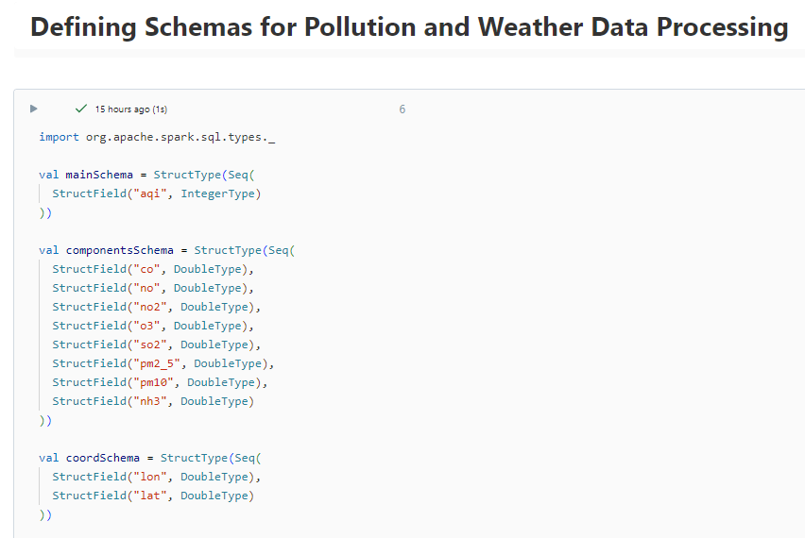
Processing
…
Notes:
In this slide, I'm detailing the efficient process of exporting data from SQL Server to CSV and then compressing it for optimal transfer speed.
I start by using BCP, which stands for Bulk Copy Program, a tool provided by SQL Server. It's the fastest method available to perform large-scale data exports to CSV format, ensuring speed and efficiency. I specify the view names that form the collection of data I wish to export, and then I initiate a loop to process each view individually.
Once the CSV files are generated, I use 7-Zip to compress them into gzip format. One of the key advantages of gzip is its compatibility with Databricks' file system. It can read gzip files directly, which means there's no need to decompress them on the platform, saving valuable processing time and simplifying the data pipeline.
The bottom part of the slide shows the actual script that orchestrates this entire process: from setting environment variables for BCP to executing the compression commands and cleaning up interim files. This script is the backbone of the procedure, handling everything from data extraction to final file compression, ready for sending to Databricks.
67’’

Slide 10
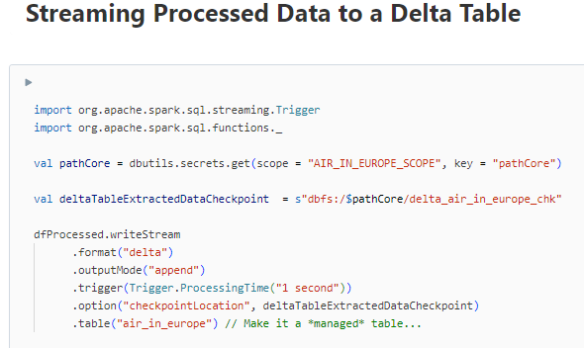
Storage (again)
Notes:
In this slide, I'm detailing the efficient process of exporting data from SQL Server to CSV and then compressing it for optimal transfer speed.
I start by using BCP, which stands for Bulk Copy Program, a tool provided by SQL Server. It's the fastest method available to perform large-scale data exports to CSV format, ensuring speed and efficiency. I specify the view names that form the collection of data I wish to export, and then I initiate a loop to process each view individually.
Once the CSV files are generated, I use 7-Zip to compress them into gzip format. One of the key advantages of gzip is its compatibility with Databricks' file system. It can read gzip files directly, which means there's no need to decompress them on the platform, saving valuable processing time and simplifying the data pipeline.
The bottom part of the slide shows the actual script that orchestrates this entire process: from setting environment variables for BCP to executing the compression commands and cleaning up interim files. This script is the backbone of the procedure, handling everything from data extraction to final file compression, ready for sending to Databricks.
67’’

Slide 11
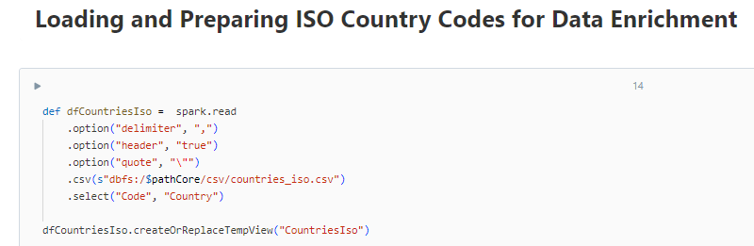
Processing
Notes:
In this slide, I'm detailing the efficient process of exporting data from SQL Server to CSV and then compressing it for optimal transfer speed.
I start by using BCP, which stands for Bulk Copy Program, a tool provided by SQL Server. It's the fastest method available to perform large-scale data exports to CSV format, ensuring speed and efficiency. I specify the view names that form the collection of data I wish to export, and then I initiate a loop to process each view individually.
Once the CSV files are generated, I use 7-Zip to compress them into gzip format. One of the key advantages of gzip is its compatibility with Databricks' file system. It can read gzip files directly, which means there's no need to decompress them on the platform, saving valuable processing time and simplifying the data pipeline.
The bottom part of the slide shows the actual script that orchestrates this entire process: from setting environment variables for BCP to executing the compression commands and cleaning up interim files. This script is the backbone of the procedure, handling everything from data extraction to final file compression, ready for sending to Databricks.
67’’

Slide 12
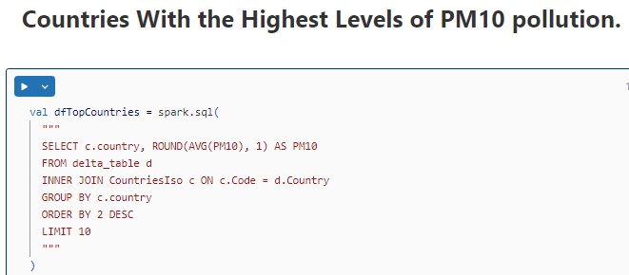
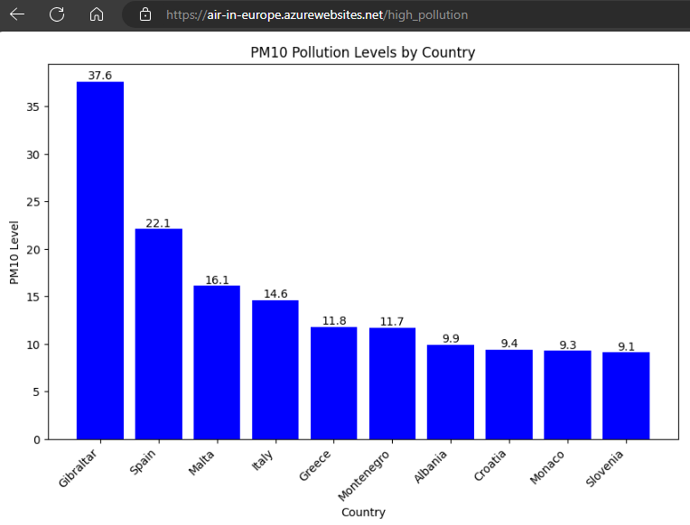
Analysis
Notes:
In this part of the presentation, I'm focusing on the data source that I used for the analysis. I have chosen the Stack Overflow database for a few key reasons:
Firstly, this database is derived from the public Stack Overflow data export, which is a rich dataset used widely in the tech community for analysis and training. It's not just a simple dataset; it reflects real-world distributions of numbers, dates, and strings, making it an excellent candidate for realistic data analysis scenarios.
For my purposes, I've selected the medium option – the 50GB StackOverflow2013 database, which expands from a 10GB compressed file. This particular dataset contains data from 2008 to 2013.
The data comes in the form of .mdf files, which are the primary database file types used by SQL Server. This makes it convenient as they can be attached directly to SQL Server without any additional conversion, saving time and simplifying the setup process.
68’’

Slide 13
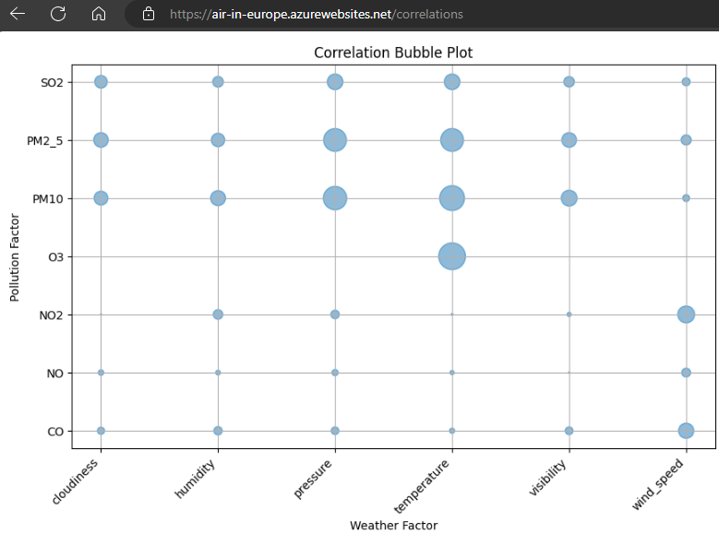
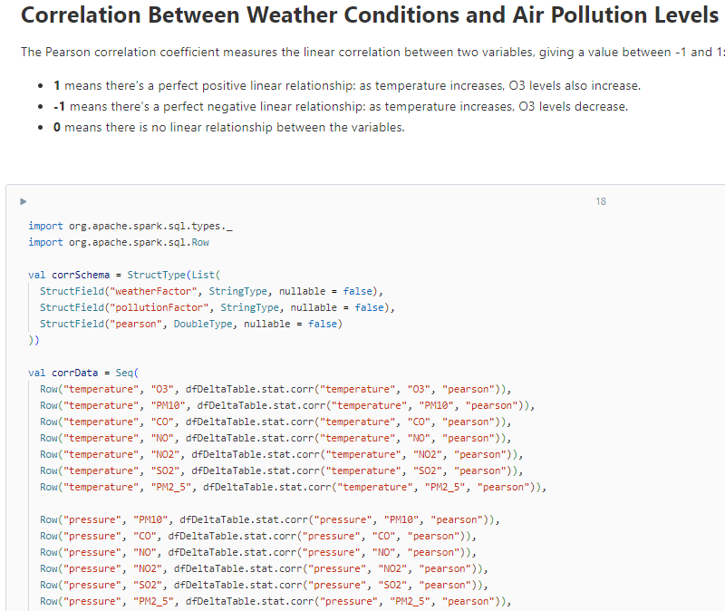
Analysis
…
Notes:
In this part of the presentation, I'm focusing on the data source that I used for the analysis. I have chosen the Stack Overflow database for a few key reasons:
Firstly, this database is derived from the public Stack Overflow data export, which is a rich dataset used widely in the tech community for analysis and training. It's not just a simple dataset; it reflects real-world distributions of numbers, dates, and strings, making it an excellent candidate for realistic data analysis scenarios.
For my purposes, I've selected the medium option – the 50GB StackOverflow2013 database, which expands from a 10GB compressed file. This particular dataset contains data from 2008 to 2013.
The data comes in the form of .mdf files, which are the primary database file types used by SQL Server. This makes it convenient as they can be attached directly to SQL Server without any additional conversion, saving time and simplifying the setup process.
68’’

Slide 14
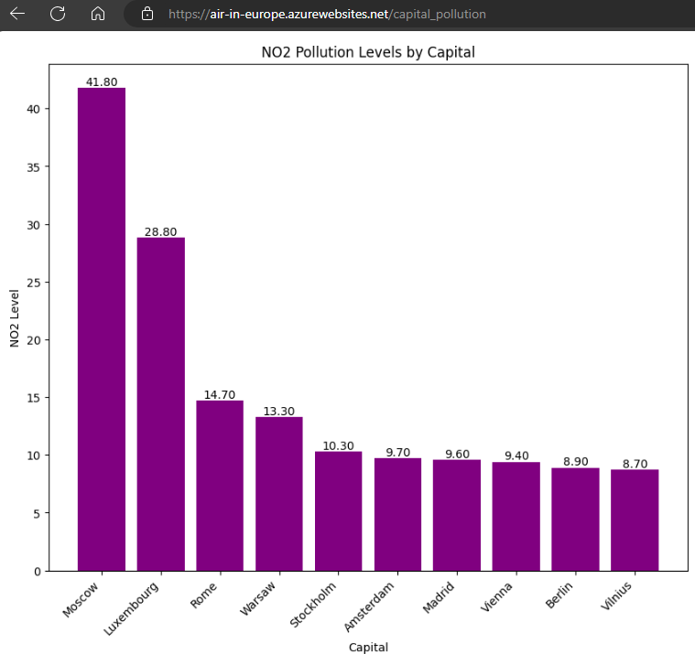
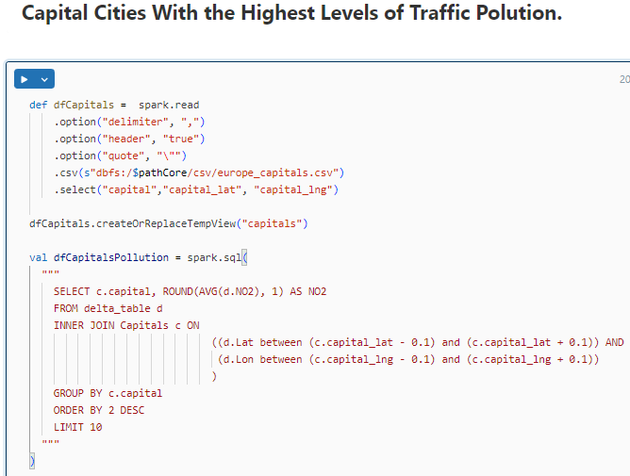
Analysis
Notes:
In this part of the presentation, I'm focusing on the data source that I used for the analysis. I have chosen the Stack Overflow database for a few key reasons:
Firstly, this database is derived from the public Stack Overflow data export, which is a rich dataset used widely in the tech community for analysis and training. It's not just a simple dataset; it reflects real-world distributions of numbers, dates, and strings, making it an excellent candidate for realistic data analysis scenarios.
For my purposes, I've selected the medium option – the 50GB StackOverflow2013 database, which expands from a 10GB compressed file. This particular dataset contains data from 2008 to 2013.
The data comes in the form of .mdf files, which are the primary database file types used by SQL Server. This makes it convenient as they can be attached directly to SQL Server without any additional conversion, saving time and simplifying the setup process.
68’’

Slide 15
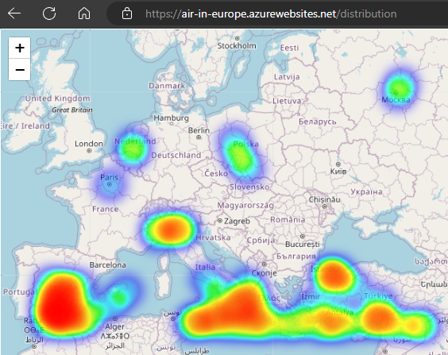
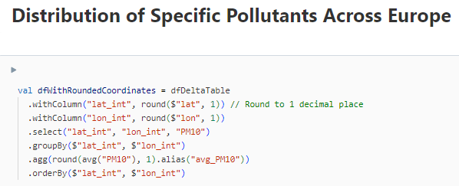
Analysis
Notes:
On this slide, I present the crucial step in data preparation: Data Cleaning. The main challenge I faced was the presence of HTML code within the text fields. This code caused problems in export procedures.
To address this, I implemented a data cleaning process through the creation of database views. These views serve a specific purpose: they remove unnecessary carriage return (\r) and newline (\n) characters from text fields. Additionally, to align with the objective of converting the data into CSV format, I needed to ensure that each text field is properly quoted.
The SQL script you see performs this transformation seamlessly. By wrapping the text fields with quotes and stripping out unwanted characters, I make the data CSV-ready. This step was not only necessary but also the most efficient route to prepare the text fields for the conversion process.
60’’

Slide 16
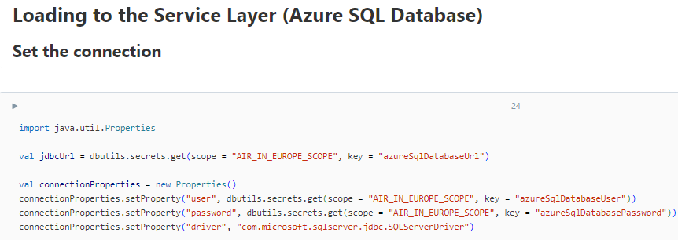
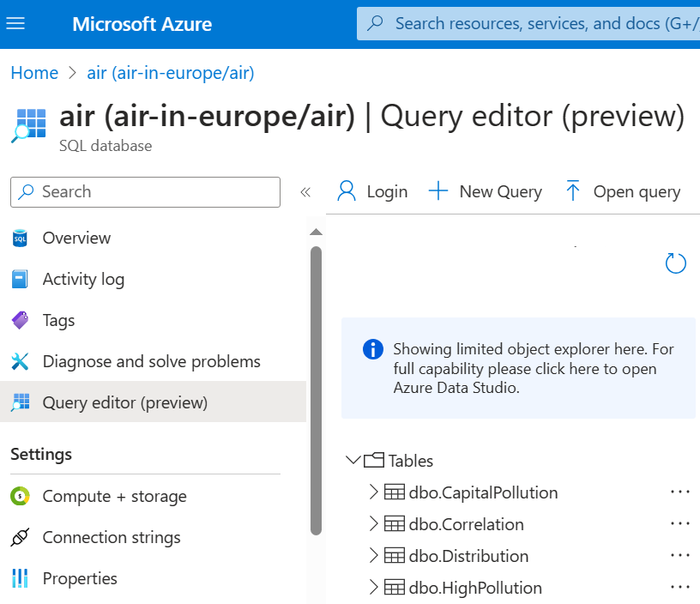
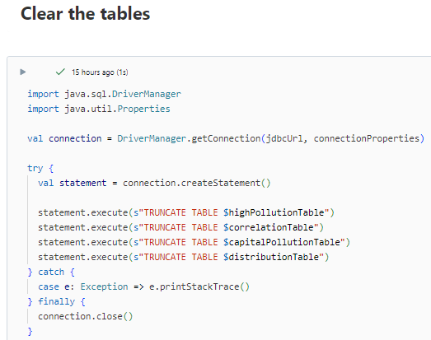
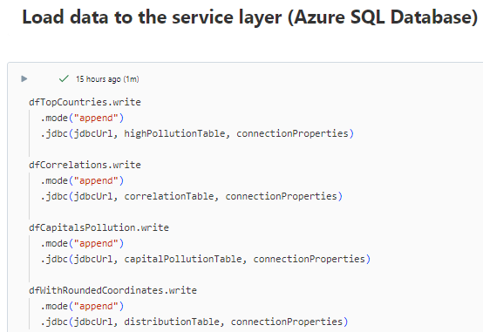
Serving Layer – Azure SQL Database
Notes:
On this slide, I present the crucial step in data preparation: Data Cleaning. The main challenge I faced was the presence of HTML code within the text fields. This code caused problems in export procedures.
To address this, I implemented a data cleaning process through the creation of database views. These views serve a specific purpose: they remove unnecessary carriage return (\r) and newline (\n) characters from text fields. Additionally, to align with the objective of converting the data into CSV format, I needed to ensure that each text field is properly quoted.
The SQL script you see performs this transformation seamlessly. By wrapping the text fields with quotes and stripping out unwanted characters, I make the data CSV-ready. This step was not only necessary but also the most efficient route to prepare the text fields for the conversion process.
60’’

Slide 17
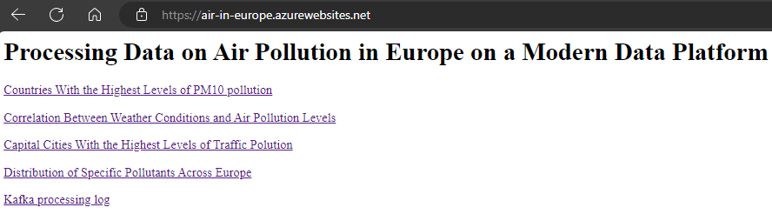
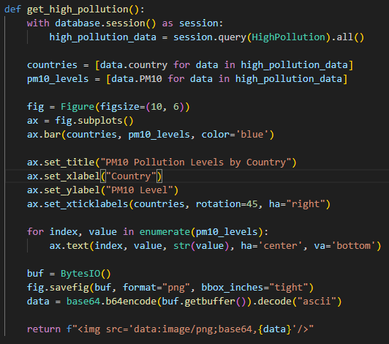
Serving Layer – Presentation in Azure Application
Notes:
On this slide, I present the crucial step in data preparation: Data Cleaning. The main challenge I faced was the presence of HTML code within the text fields. This code caused problems in export procedures.
To address this, I implemented a data cleaning process through the creation of database views. These views serve a specific purpose: they remove unnecessary carriage return (\r) and newline (\n) characters from text fields. Additionally, to align with the objective of converting the data into CSV format, I needed to ensure that each text field is properly quoted.
The SQL script you see performs this transformation seamlessly. By wrapping the text fields with quotes and stripping out unwanted characters, I make the data CSV-ready. This step was not only necessary but also the most efficient route to prepare the text fields for the conversion process.
60’’

Slide 18
Conclusions
The use of a Modern Data Platform has revealed that the most polluted air is in Southern Europe.
The analyses conducted were limited to only a portion of the processed data, so the results could be more diverse and interesting.
More information would be provided by comparing current data with historical data.
The presentation may look more professional with the use of specialized tools like Tableau.
Notes:
This slide summarizes the key findings from the analysis. The most significant observation is that the bulk of the time was spent on cleaning the data, which underscores the importance of having clean data for accurate analysis. I noted that Spark was highly efficient in handling Parquet files, though it’s crucial to provide the correct schema upfront to ensure smooth processing.
Another point of interest is the observation that using regular expressions proved to be quite slow, which suggests the need for more efficient text processing methods in future analyses. Lastly, considering the overall data pipeline performance, deploying a database on Azure SQL Database and connecting it directly to Databricks could offer a more streamlined and faster approach.
42’’

